Slide 1

How we're reverse engineering the human brain in the lab Sergiu p. Pasca
Made by Martynas Kuliešius

Slide 2
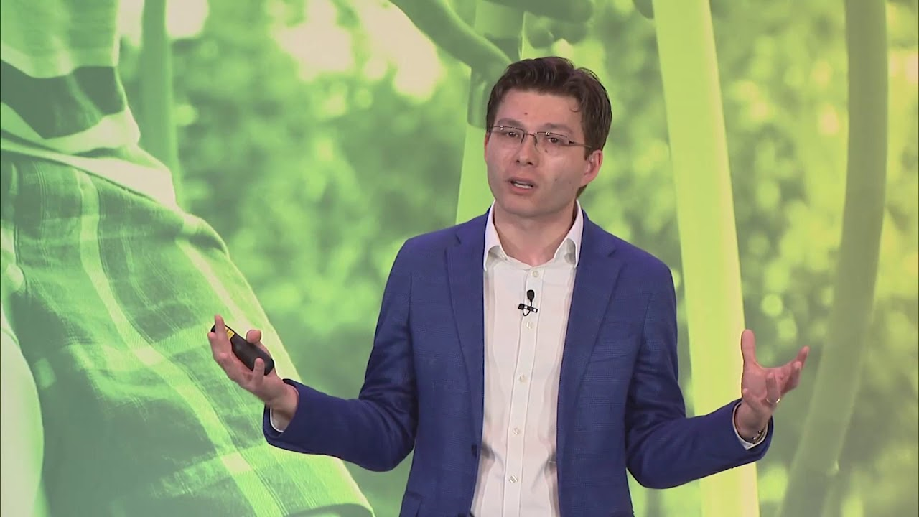

Slide 3
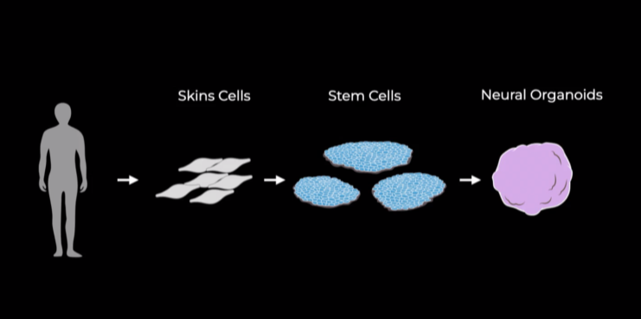

Slide 4
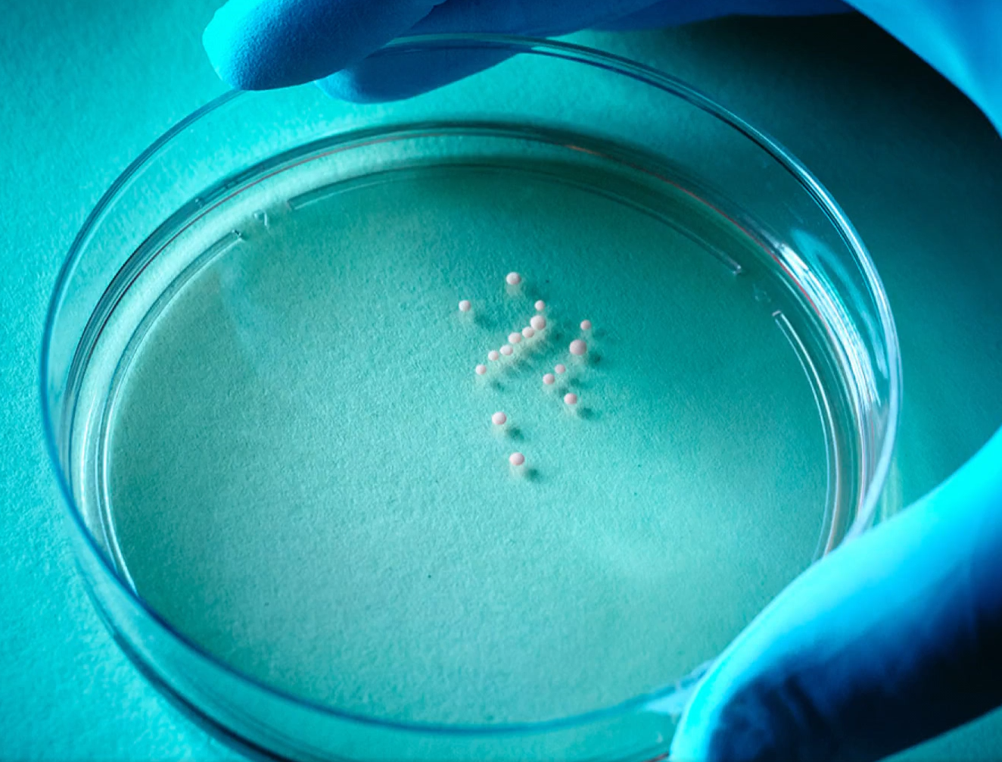

Slide 5
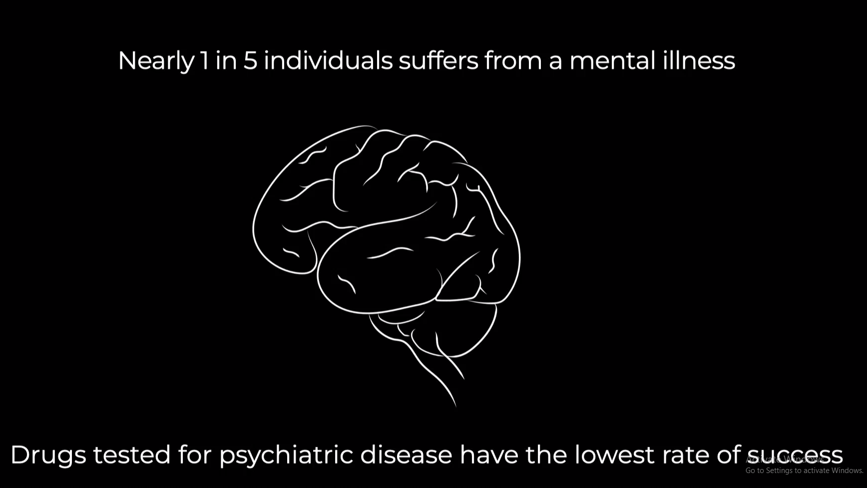

Slide 6
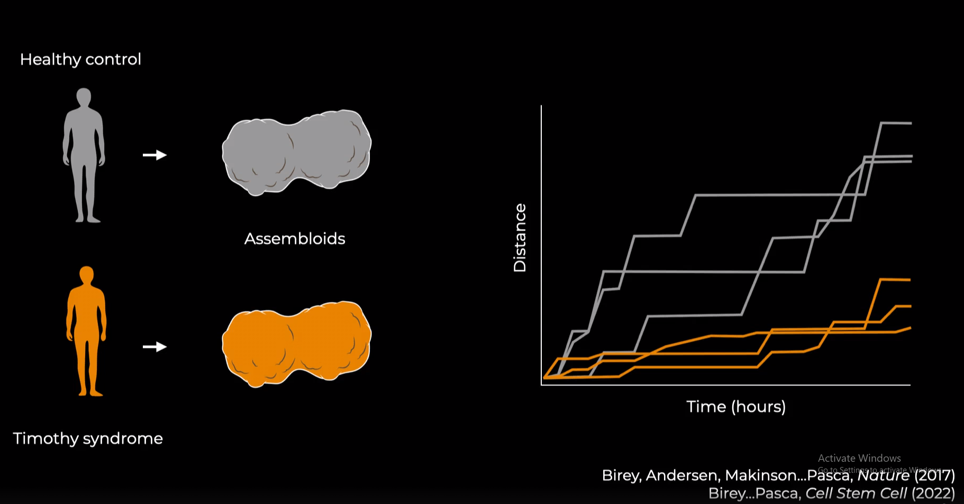

Slide 7
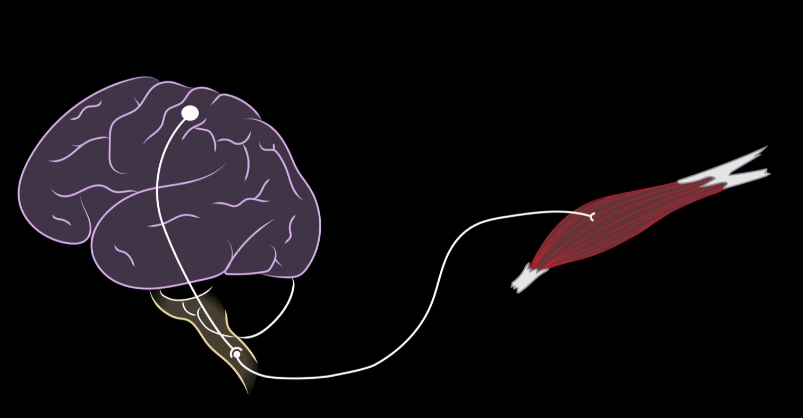

Slide 8
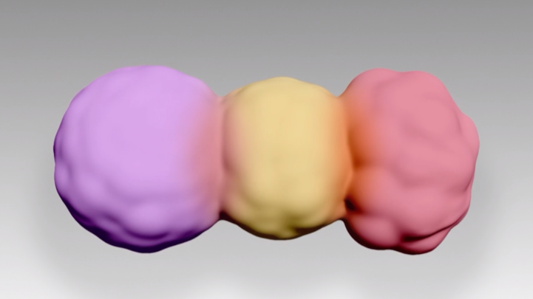

Slide 9
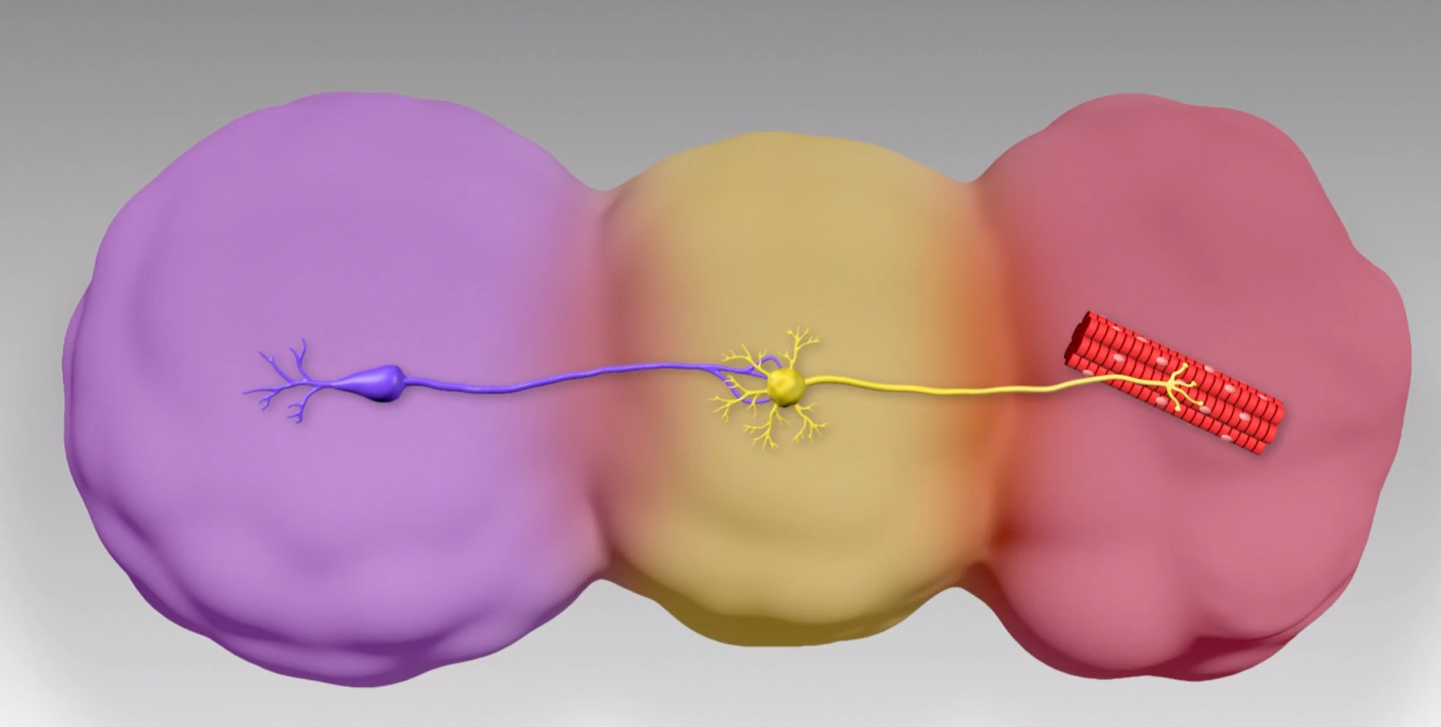

Slide 10
Resource:
https://www.ted.com/talks/sergiu_p_pasca_how_we_re_reverse_engineering_the_human_brain_in_the_lab

